Slide 1
Background Tasks with Worker Service

Slide 2
Objectives
Overview Worker Service .NET
How to implement a Background Task by Worker Service
Overview Windows Service
Demo create Worker Service to consume ASP.NET Core Web API
Demo to publish Worker Service as a Windows Service

Slide 3
Understanding Worker Service .NET
A worker service is a .NET project built using a template which supplies a few useful features that turn a regular console application into something more powerful
A worker service runs on top of the concept of a host, which maintains the lifetime of the application. The host also makes available some familiar features, such as dependency injection, logging and configuration
Worker services will generally be long-running services, performing some regularly occurring workload such as:
Processing messages/events from a queue, service bus or event stream
Reacting to file changes in an object/file store
Aggregating data from a data store
Enriching data in data ingestion pipelines
Formatting and cleansing of AI/ML datasets

Slide 4
Understanding Worker Service .NET
It’s also possible to develop a worker service which performs a process from start to finish and then shuts down. Coupled with a scheduler, this can support periodical batch workloads
For example, every hour the service is started by the scheduler, calculates some aggregate totals and then shuts down
Worker services do not have a user interface, nor will they support direct user interaction. They are particularly applicable when designing a microservices architecture. Here responsibilities are often split into distinct, separately deployable and scalable services

Slide 5
Understanding Worker Service .NET
Use a host to maintain the lifetime of the console application until the host is signalled to shut down. Turning a console application into a long-running service
Include features common to ASP.NET Core such and dependency injection, logging and configuration
Perform periodic and long-running workloads
Background tasks can be implemented in two ways: Implementing IHostedService Interface and Inheriting BackgroundService Class

Slide 6
The BackgroundService Class
BackgroundService is an abstract base class for implementing a long-running IHostedService. Using BackgroundService class we can write less code as compared to IHostedService
The following table describes some of the key methods:
Method | Description
StartAsync(CancellationToken) | Triggered when the application host is ready to start the service
StopAsync(CancellationToken) | Triggered when the application host is performing a graceful shutdown
Dispose() | Performs application-defined tasks associated with freeing, releasing, or resetting unmanaged resources
Equals(Object) | Determines whether the specified object is equal to the current object. (Inherited from Object)
ExecuteAsync(CancellationToken) | This method is called when the IHostedService starts. The implementation should return a task that represents the lifetime of the long running operation(s) being performed

Slide 7
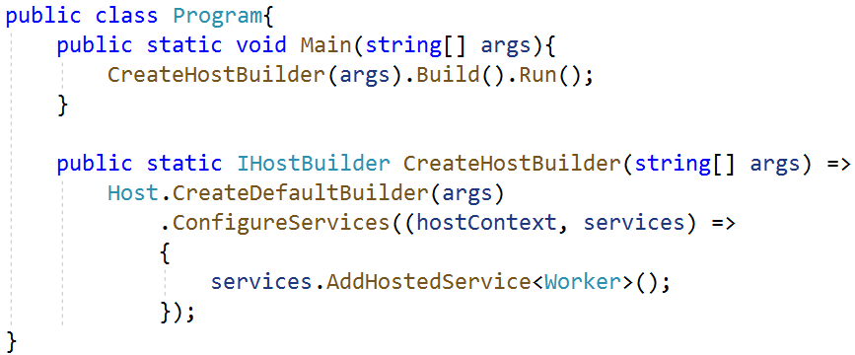
The Worker Service Template Provide
The worker service template includes useful foundational components, like dependency injection, by default so that we can focus on building our business logic on top. It includes a host which manages the lifecycle of the application
The worker service template is reasonably basic and includes just three core files:
Program.cs: The first of which is a Program class. This class consists of the required Main method entry point for .NET console applications. The .NET runtime expects to locate this method within the Program class when it starts your .NET application

Slide 8
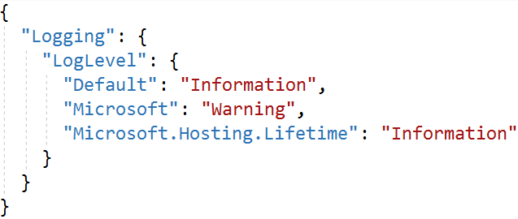
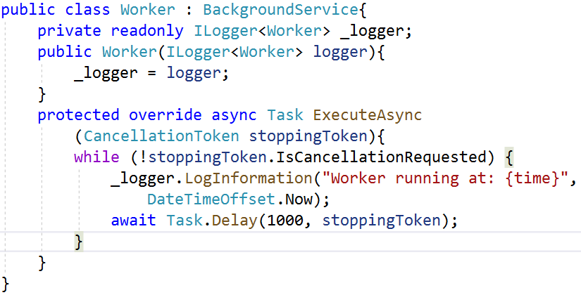
The Worker Service Template Provide
appsettings.json: It is one of the common sources for application configuration. The host is configured to load application configuration from several sources when the application starts using any registered configuration providers
Worker.cs: The Worker class is something new which you will not find in the default ASP.NET Core project template. This is where the magic of hosted services, combined with the host, provide the basis of a worker service

Slide 9
Demo 01: Create a Worker Service using Visual Studio.NET

Slide 10
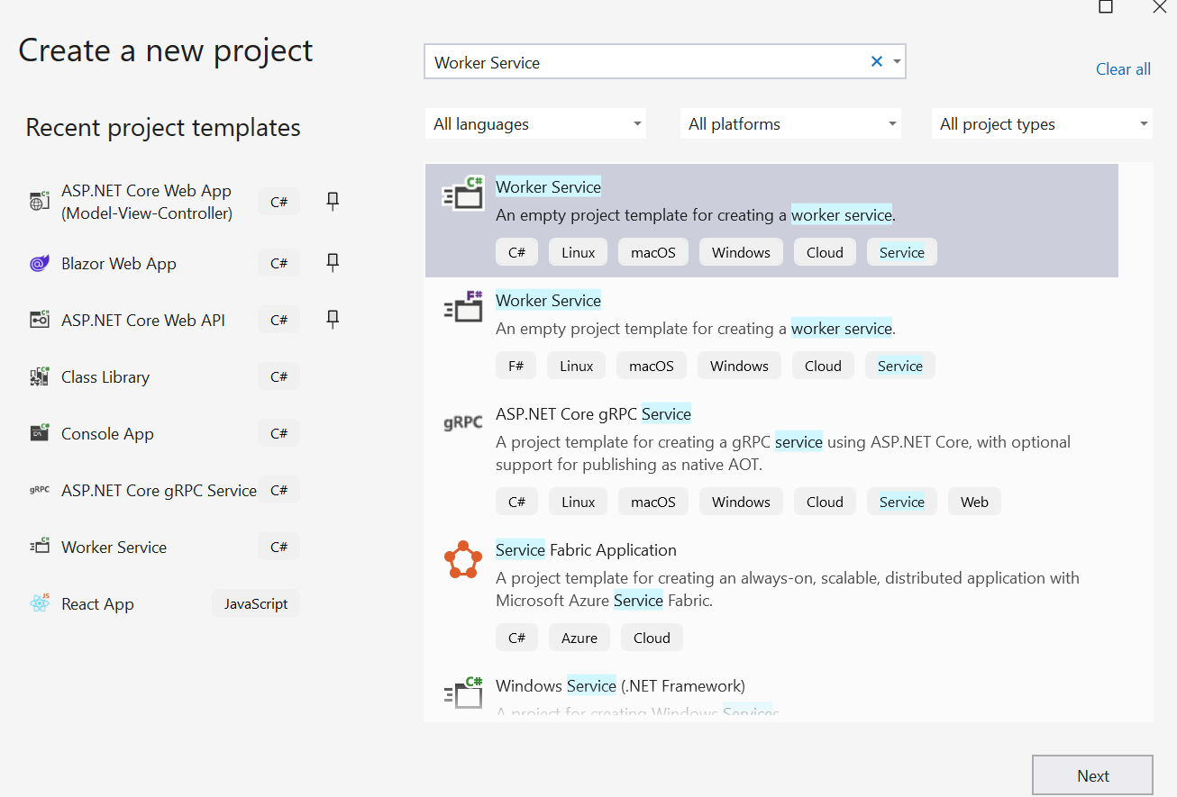
1. Open Visual Studio.NET , File | New | Project
1
2
3

Slide 11
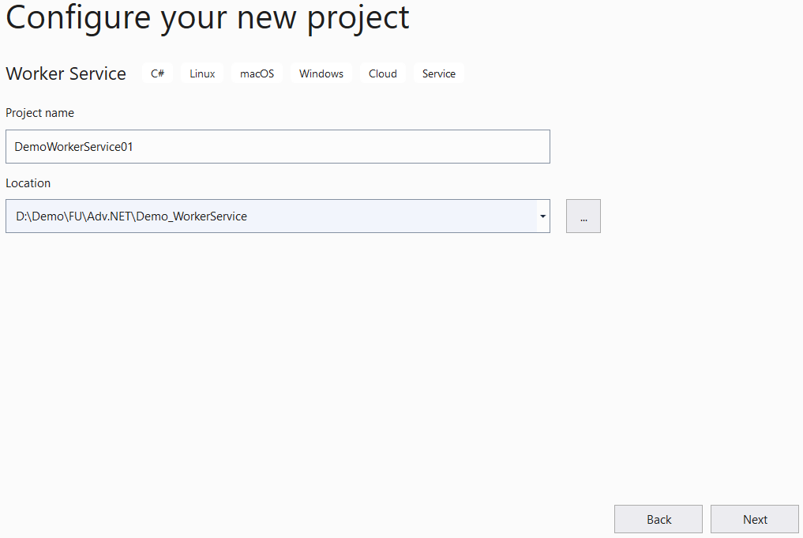
2. Fill out Project name: MyWPFApp and Location then click Next
4
5

Slide 12
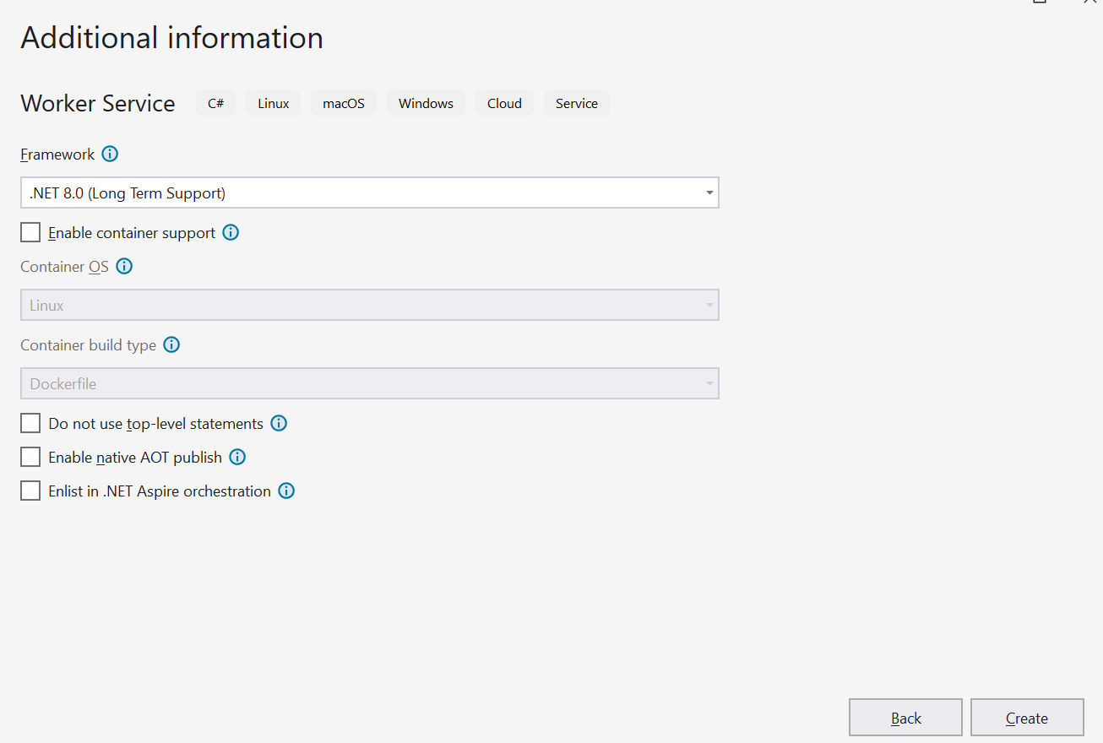
3. Choose Target Framework: .NET 8 then click Create
6
7

Slide 13
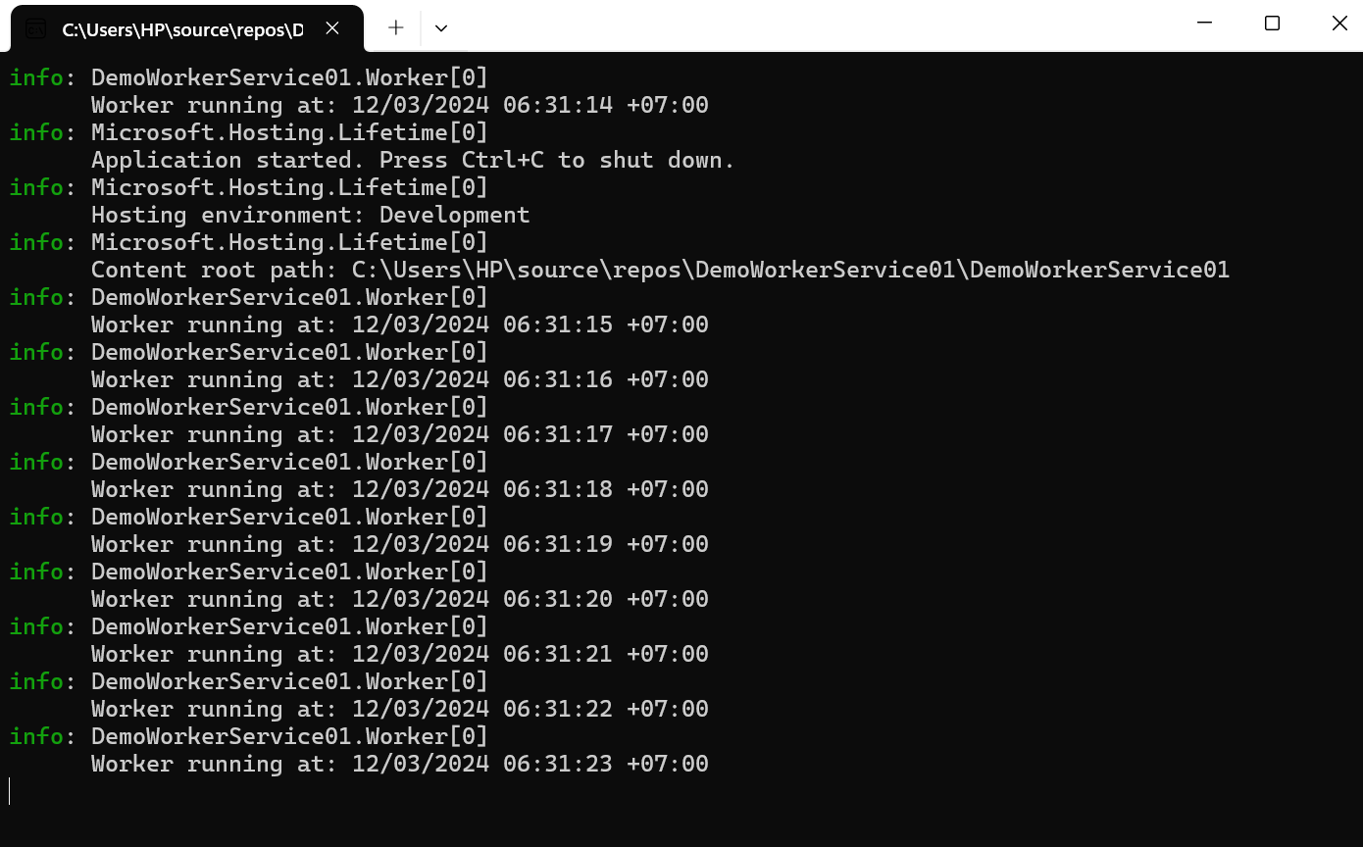
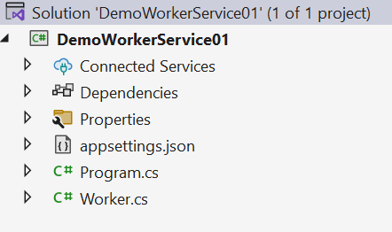
4. Run the project

Slide 14
Demo 02: Worker Service and Web API

Slide 15
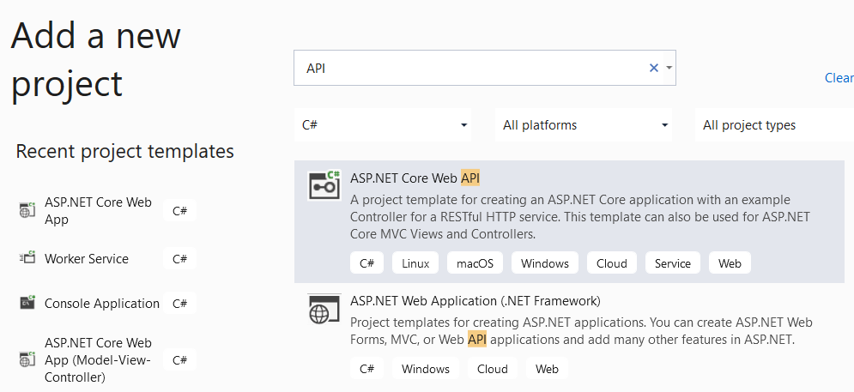

Worker Service Demo-02
Create a background task that use HttpClient to call a API service to retrieve the current exchange rate between various currencies, and print the result
1.Open the Visual Studio.NET then create ASP.NET Web API Project named ExchangeRateService
1
2

Slide 16
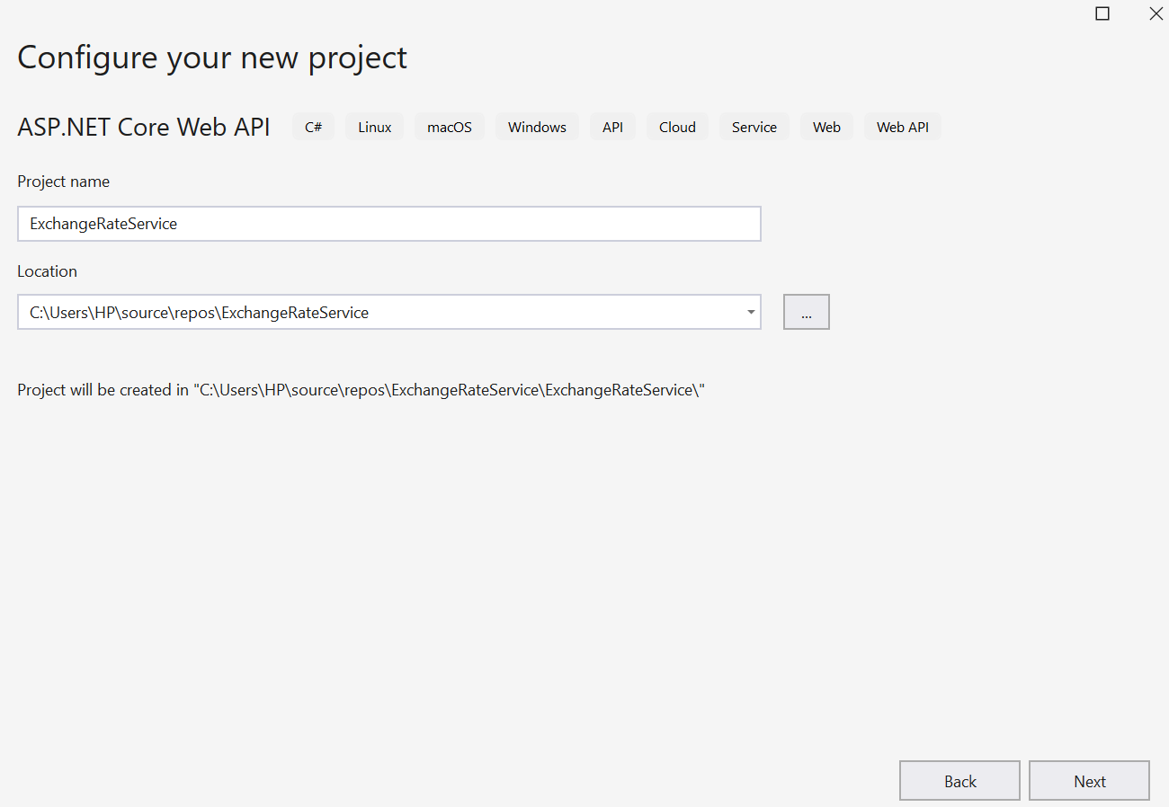
Worker Service Demo-02
3
4

Slide 17
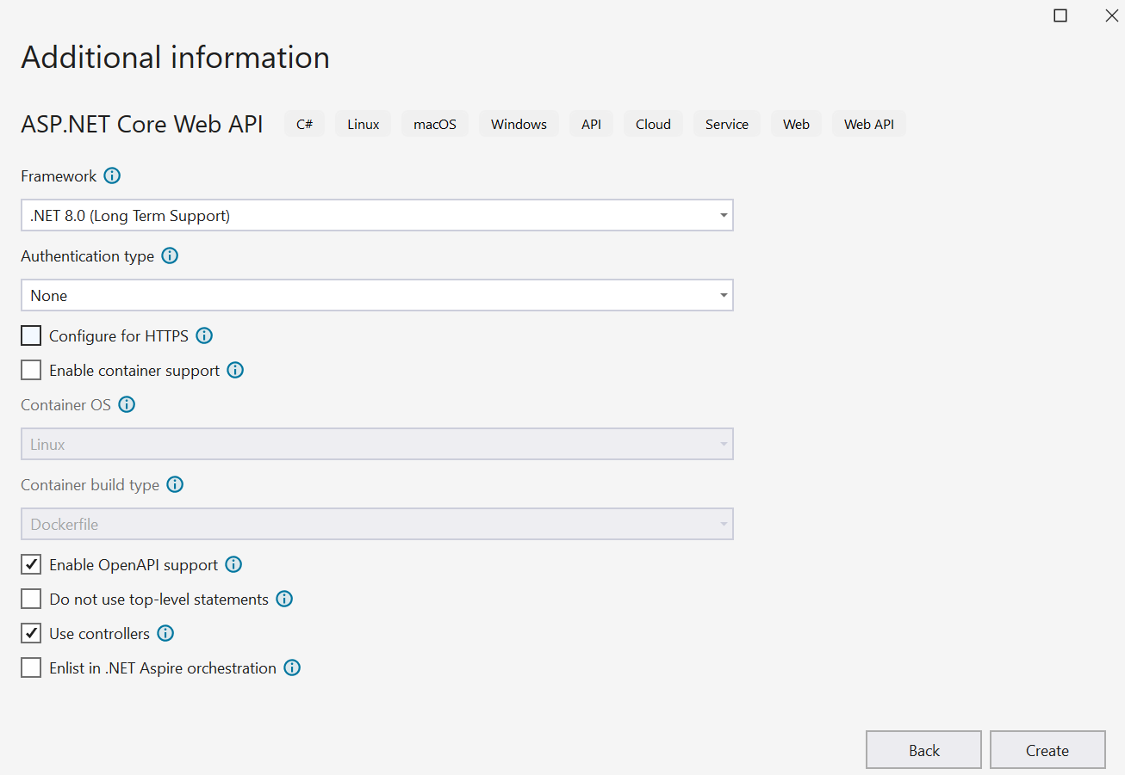
Worker Service Demo-02
5
6

Slide 18
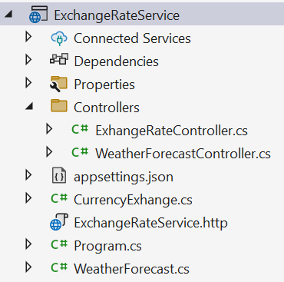
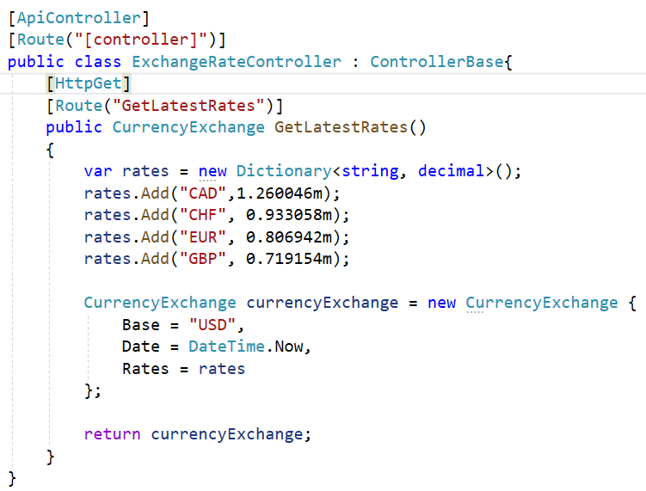
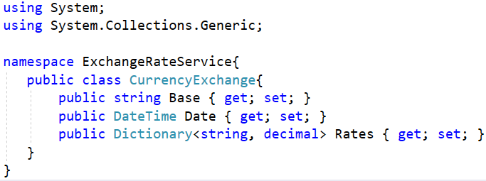
2.Write codes for the ExchangeRateService project as follows:

Slide 19
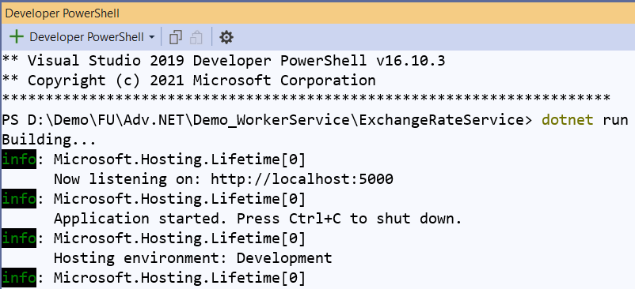
3. Right-click on the project, select Open in Terminal. On Developer PowerShell dialog, execute the following command to run Web API project

Slide 20
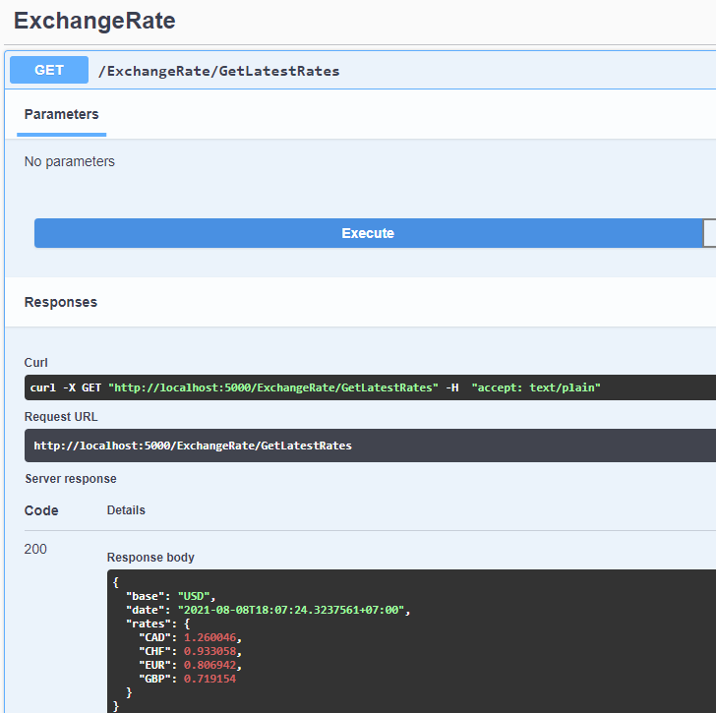
4. Open the web browser and enter the following link to test GetLatestRates method with Swagger : http://localhost:5000/swagger/index.html

Slide 21
Summary
Concepts were introduced:
Overview Worker Service .NET
How to implement a Background Task by Worker Service
Demo create Worker Service to consume ASP.NET Core Web API

